Slide 1

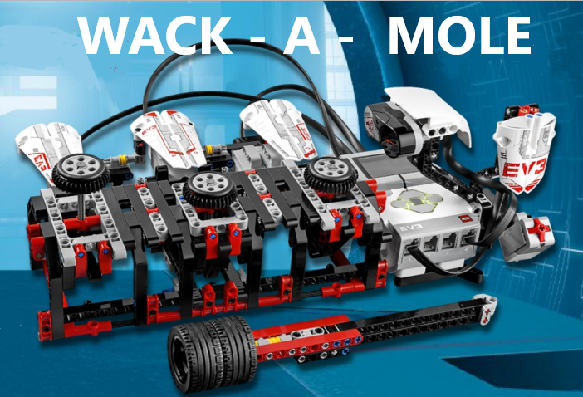
Team Members:
Muhammad Sami Ullah Muhammad Ali M Hibbaan Abdullah

Slide 2

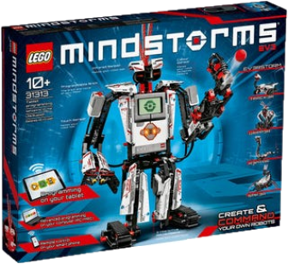
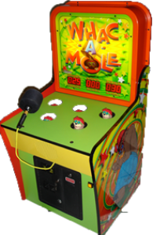

Motivation
Artificial intelligence and Robotics is a key branch of Electrical Engineering.
We also had some introduction to Lego Mindstorm in our Lab.
This model is inspired by a famous arcade game called “Whack-a- Mole”

Slide 3

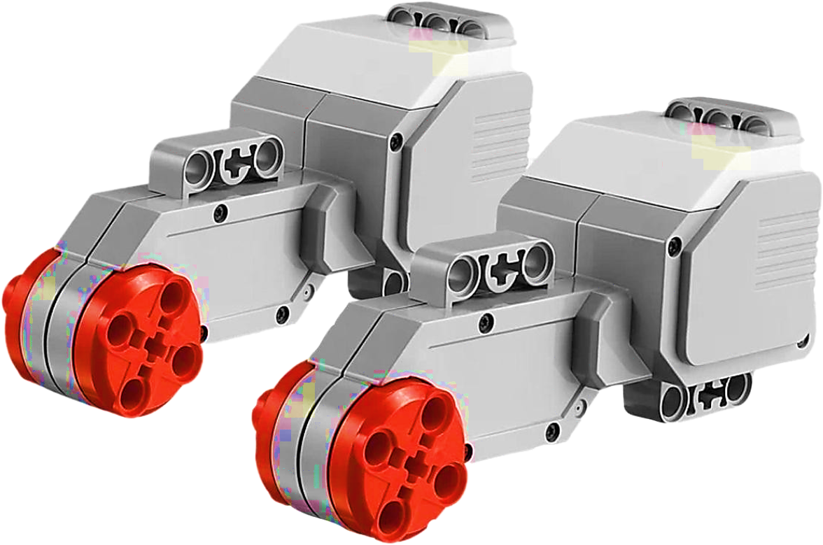

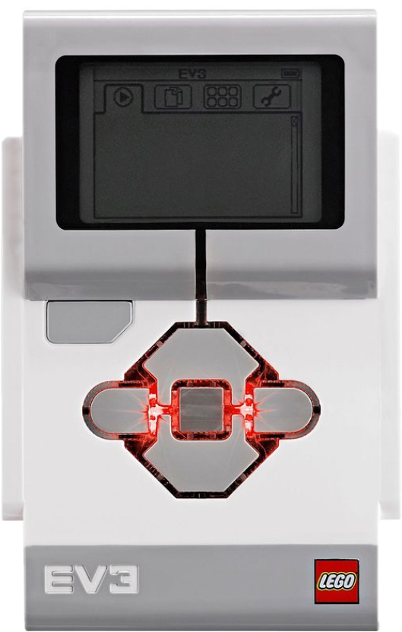
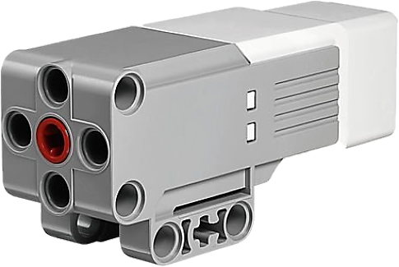
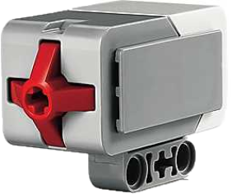
Components
This is the brain which stores the code at take input and gives output signals
Infrared Sensor
This sensor detects the hammer when it hits the mole
Large Motors
These motors pop up the “moles”
This sensor is used to start and end the game
EV3 Brick
Touch Sensor
Medium Motor

Slide 4

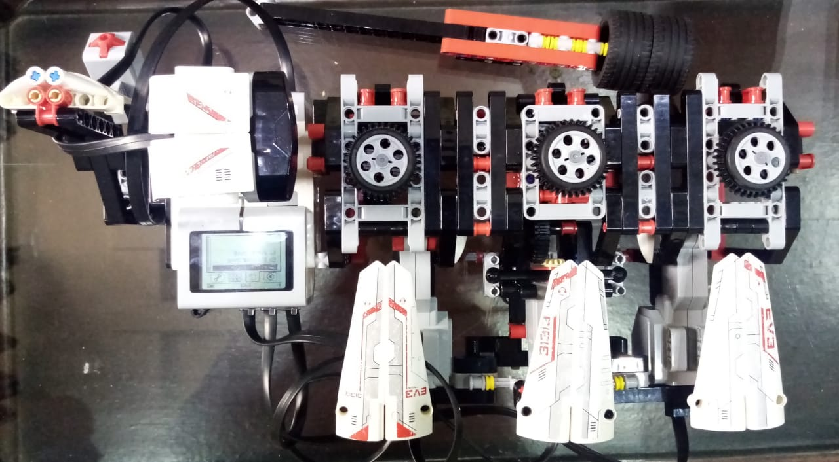
labelling
Touch Sensor
Hammer to hit the “moles”
Mole
Infrared Sensor
Motors
EV3 Brick

Slide 5

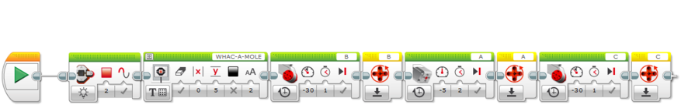
Program
Initializer Function:
This function resets the rotation values of motors

Slide 6

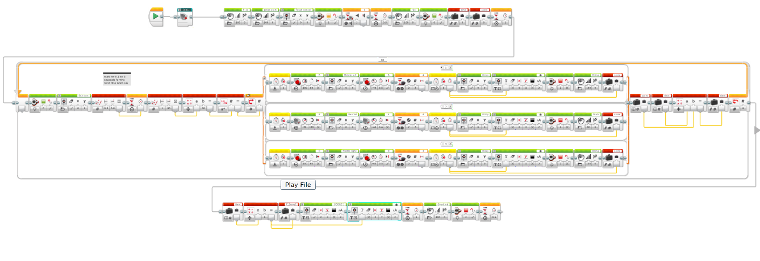
Player 1 Function:
Initializer function as defined
previously
Waits for the user to press the button. Also introduces score and time variable.
Generates any integer from one to three
Adds the time of each hit & repeats the process 6 times
Stores the average time in F_Score1 variable & displays it
This switch block pops up any one “mole” depending upon generated integer
F_Score2 instead in Player 2 Function

Slide 7

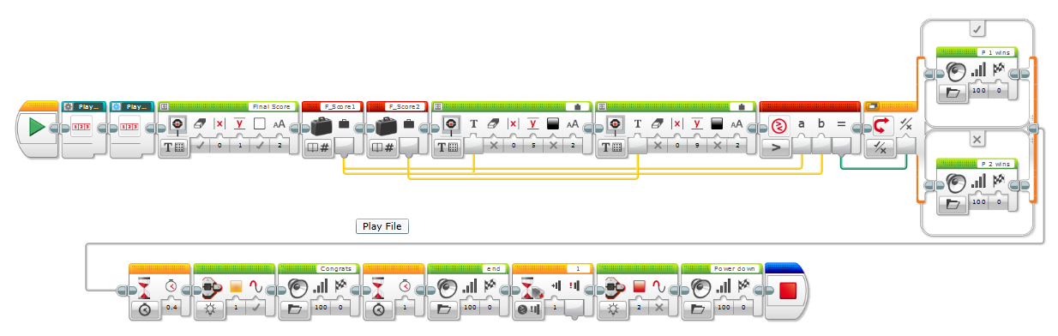

Result Function:
These are the functions for player 1 & player 2 and contains their final scores
Compares both scores and announces
the winner
Displays the final scores of both players on the screen
Congratulates the winner and ends the
Program

Slide 8

Demonstration

Slide 9
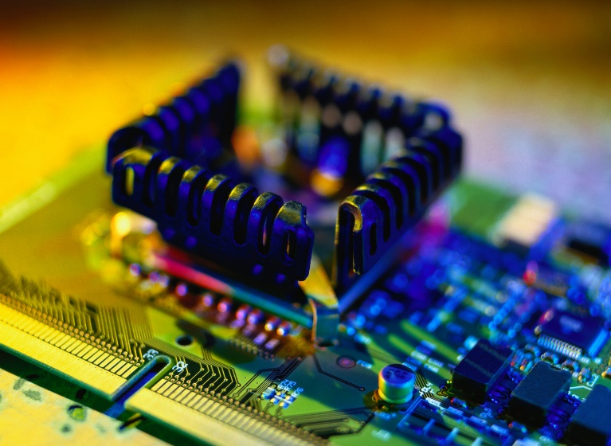
Conclusion
This project a is apt depiction of how software and hardware work together
We hope this project incites your interest towards the world of Robotics and Artificial Intelligence (AI).

Slide 10

Q/A

Slide 11

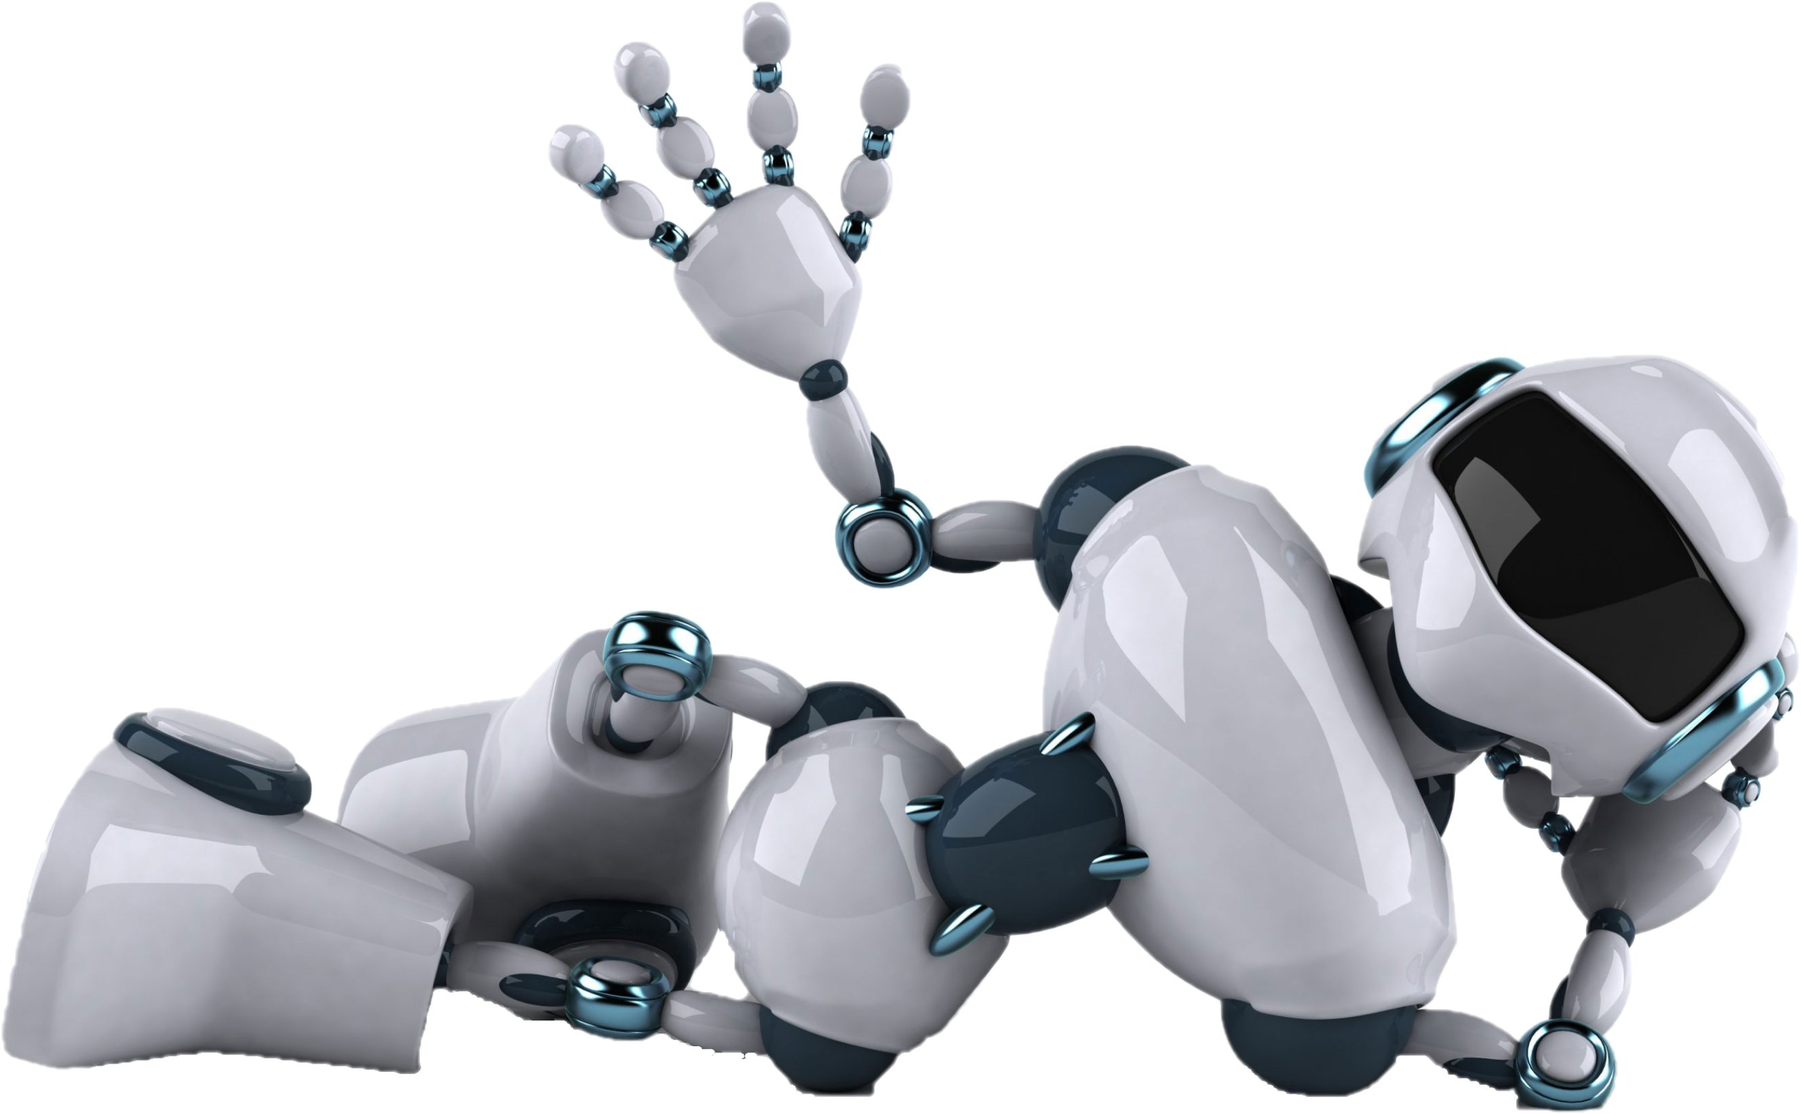
Thank You

